Slide 1
머신러닝을 이용한
투자 포트폴리오 구성 결과 브리핑
김홍재
남보현
남승균
최수인
조윤하
홍현지

Slide 2
Our window
1. Hyperparameter Tuning
2. Fitting & Predicting
150 Work days
7 Work days
When Tuning
When Fitting & Predicting
Train
Valid
Train
Valid
Train
Test
150 Work days
7 Work days
157 Work days
7 Work days
Train
Valid
150 Work days
7 Work days
Train
Valid
150 Work days
7 Work days
Train
Valid
150 Work days
7 Work days
….

Slide 3
Our Algorithm
Raw data
Handled Data
Ridge
Lasso
ElasticNet
MLP
Gradient
Boosting
Weighted Average
Score
Portfolio

Slide 4
Our Prediction Accuracy

Slide 5
Our Prediction Accuracy

Slide 6
Our Prediction Accuracy

Slide 7
Our Result

Slide 8
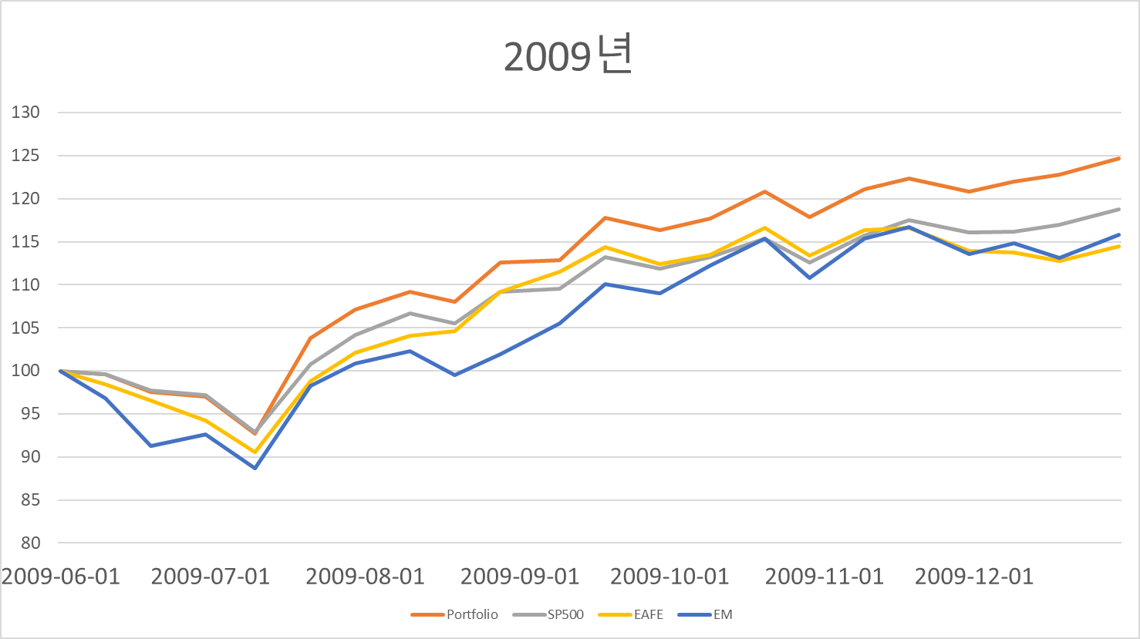
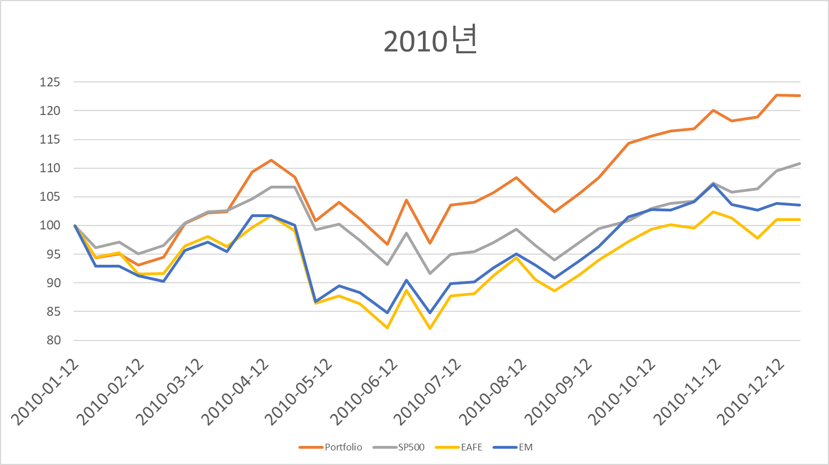
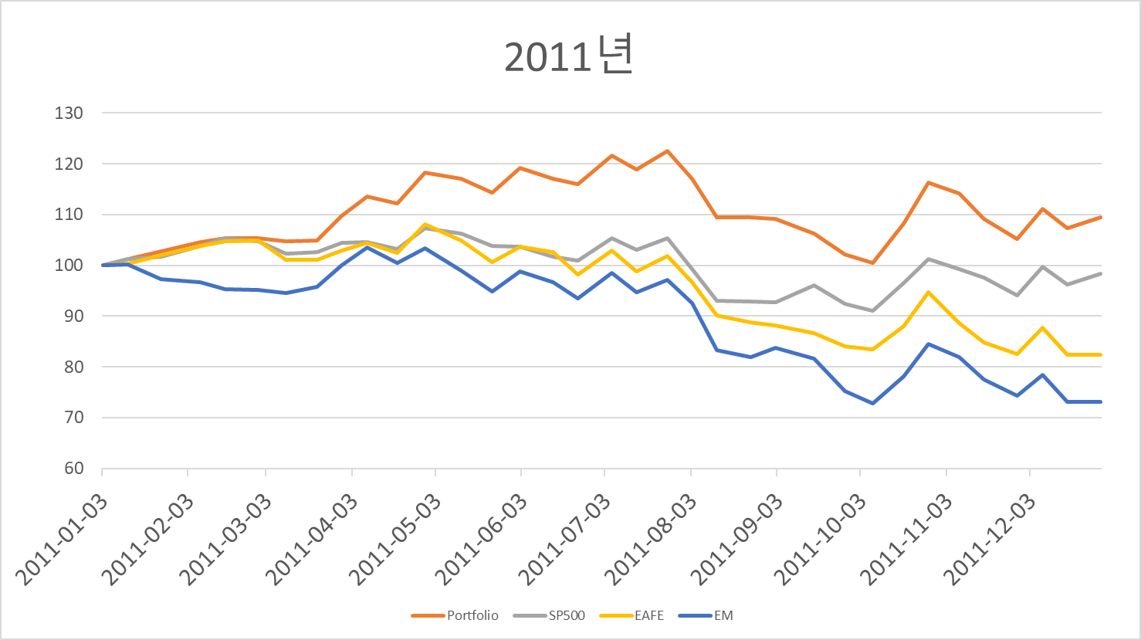
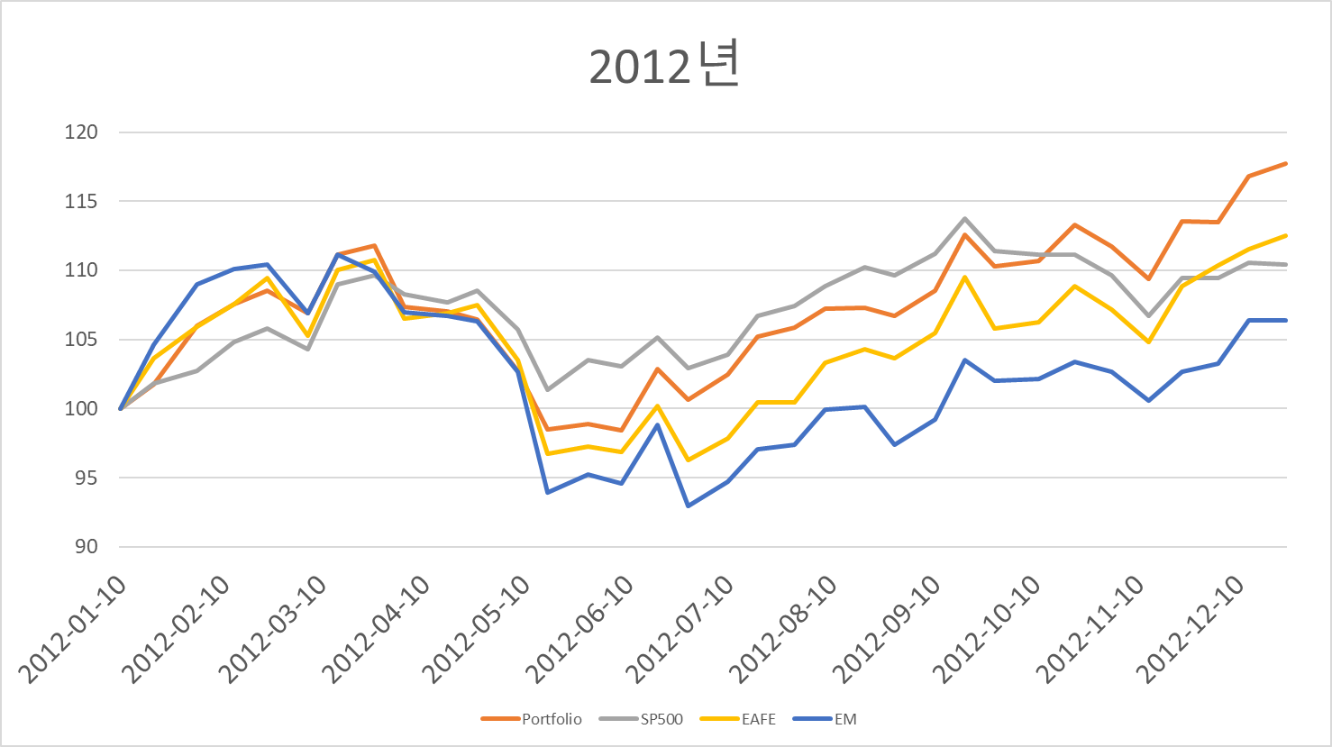
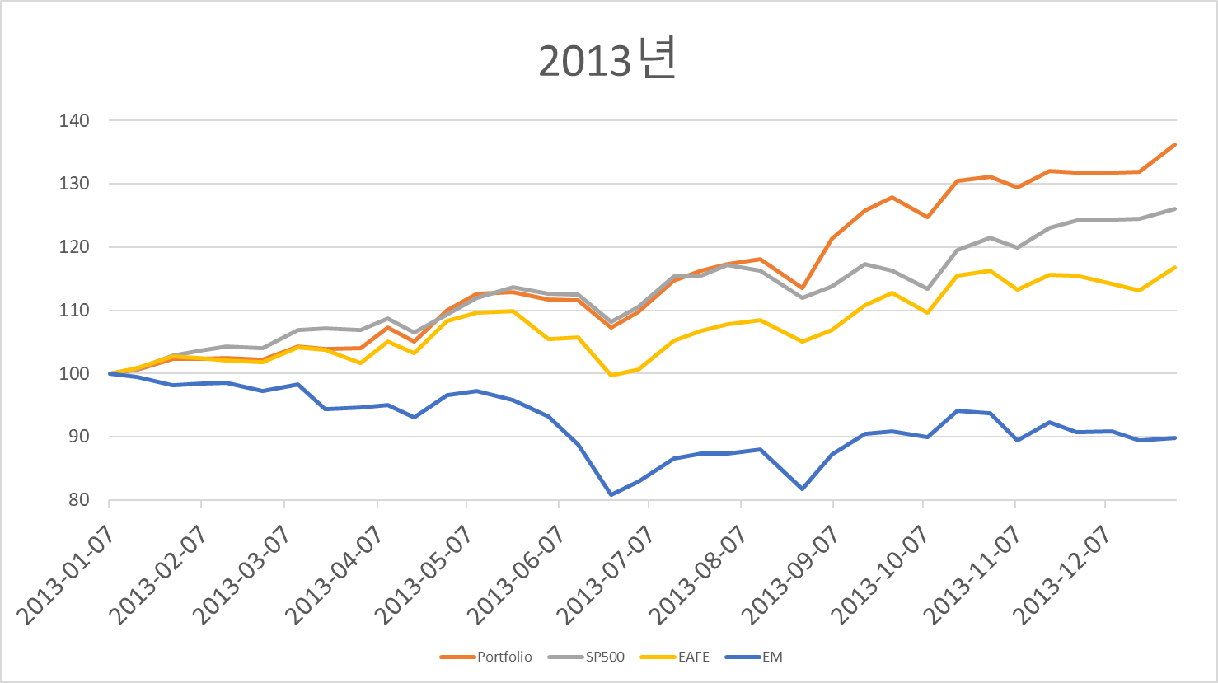
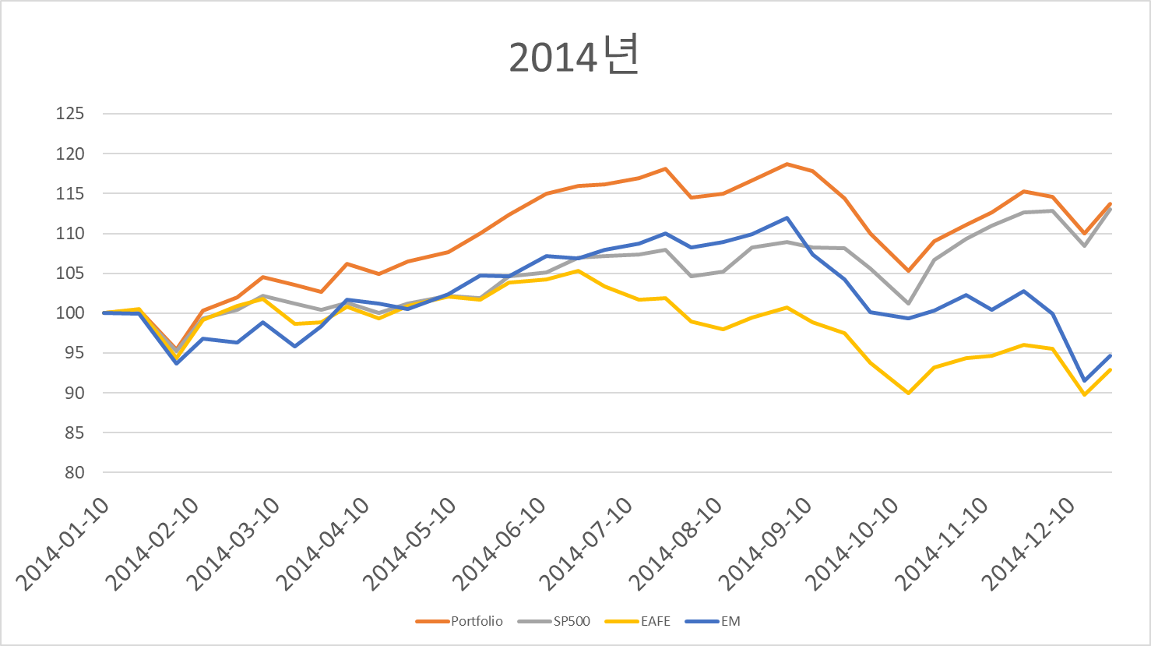
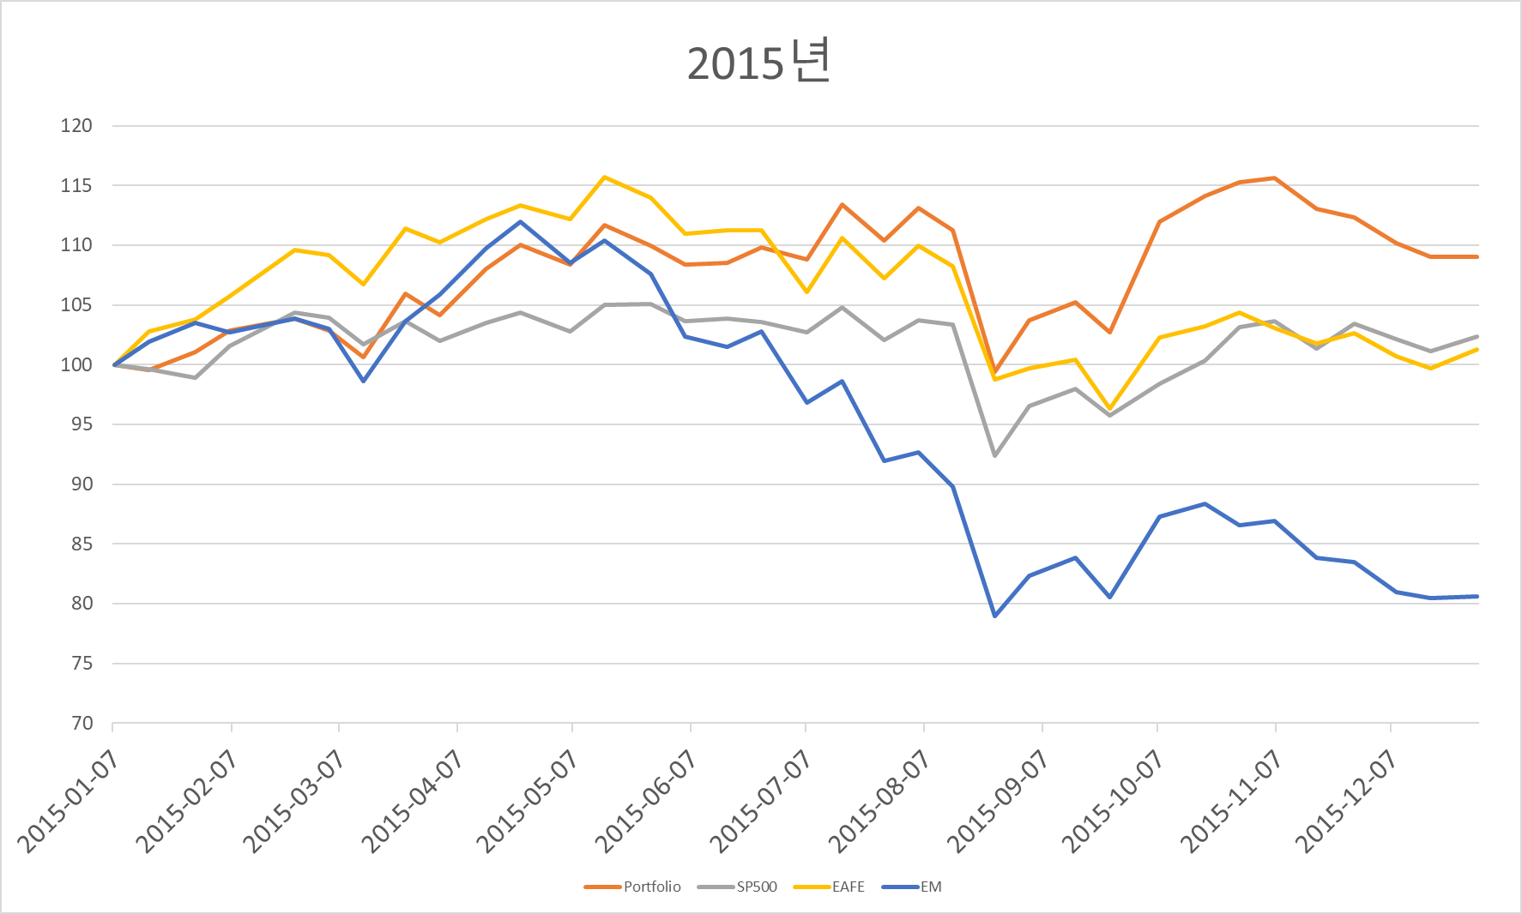
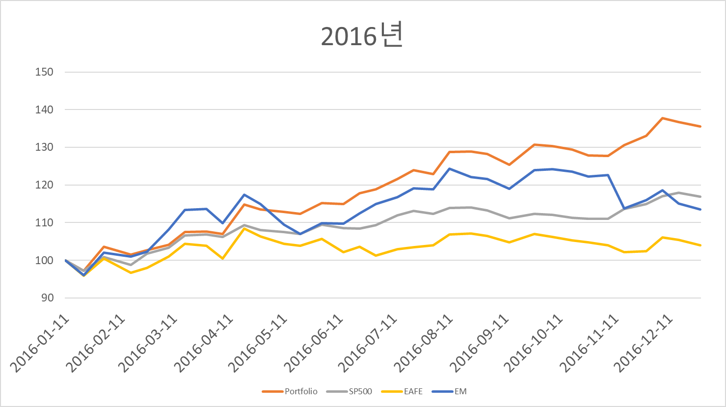
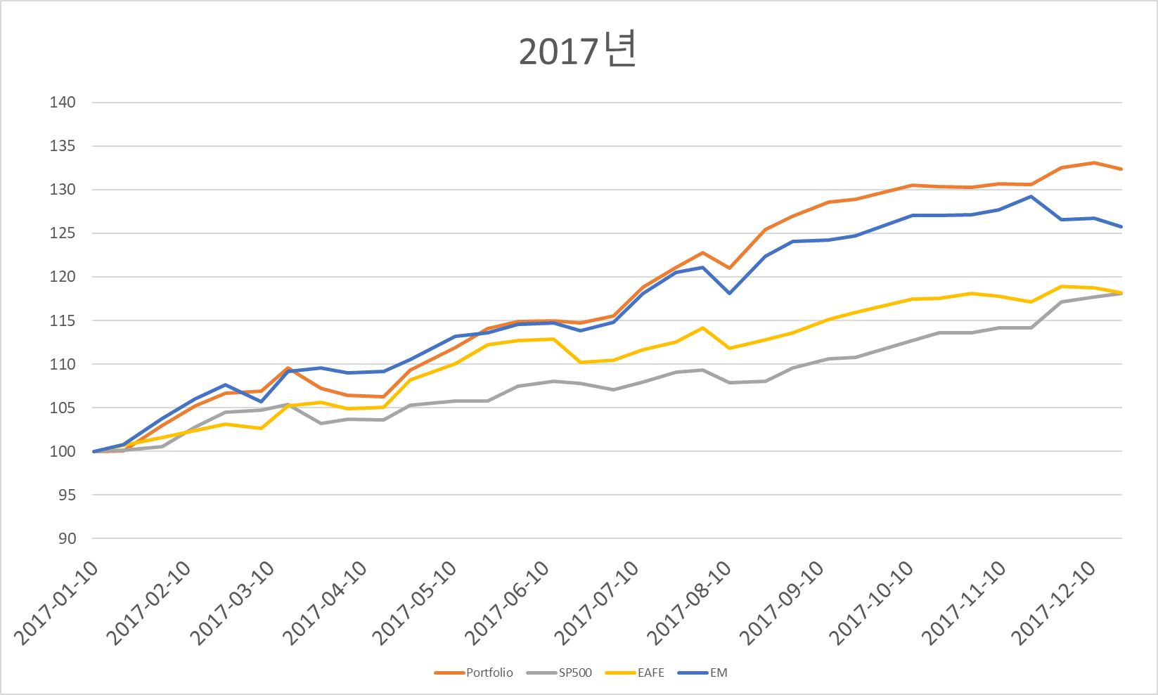
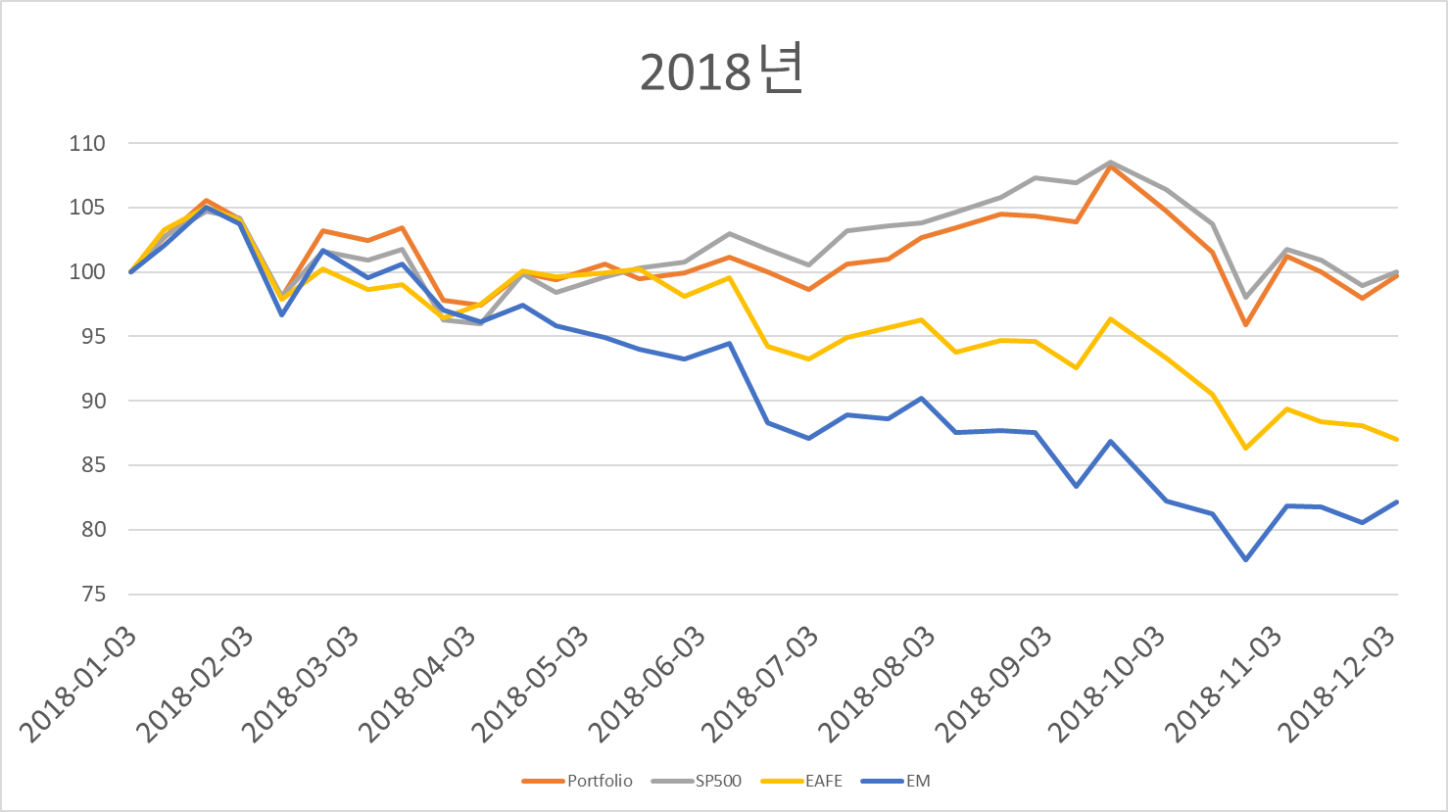
Yearly Graph

